Slide 1
Using Machine Learning to Predict Tornadoes
Scott burgholzer
Lewis university – data science capstone 2019

Slide 2
Can Machine Learning Be Used To Predict Weather?
Research is already indicating yes
Studies have shown improvement over existing weather models
Mesoscale Convective Systems (MCS) identification [4]
Storm duration [5]
Hurricane intensity [6]
Can it be extended to tornado prediction
Purpose of this study
Can it be extended to Sub-Seasonal to Seasonal Forecasting
Future work?
Notes:
Cohen et al used clustering methods and multilinear regression for winter weather precipitation hindcasts in Europe. Compared to existing models, their results showed improvement [1].
Hwang et al. Used an ensemble of ML to predict temperature and precipitation[2]
Homstrom et al. used linear regression to predict high and low temps. Short term forecasts were off compared to professional forecasts, but their results improved further out in time [3]
Haberlie and Ashley used random forests, gradient boosting and XGBoost to reduce false positive identifications of MCS [4]
McGovern et. al used gradient boosted regression trees, random forests and elastic nets to predict duration of a storm [5]
Ghosh and Krishnamurti used generalized regression neural network to improve hurricane intensity forecasts [6]
These are just a few, but there are many other studies out there

Slide 3
Ethical Considerations
None in this study
No Personally Identifiable Information
Personally Identifiable Information taken care of by Storm Prediction Center
Notes:
No personally identifiable information anywhere in the data used in this study
Storm Prediction dataset does have number of injuries and deaths in it
This study doesn’t use those fields and if it did, those fields are just numerical, no personal information anywhere

Slide 4
Data
North American Regional Reanalysis (NARR)
Storm Prediction Center Tornado Reports
Notes:
NARR – 6.92 TB of data, January 1, 1979 through October 31, 2019, 32 km x 32 km grid layout
Tornado – 1950 to 2018, only initial point of all tornadoes

Slide 5
Meteorological Variables Used
2 meter Temperature
2 meter Dewpoint Temperature
Surface Convective Available Potential Energy (CAPE)
Surface Convective Inhibition (CIN)
Surface Potential Temperature
Surface Pressure
Precipitable Water (PWAT)
2 meter Relative Humidity (RH)
Storm Relative Helicity (SRH)
Lifted Index
10 meter wind speed
250 millibars (mb), 500 mb, 700 mb, 850 mb and 925 mb
Geopotential Height
Temperature
Wind Speed
Notes:
Will explain convective parameters next
Out of all variables in the NARR by default, these seemed to be the best for this study

Slide 6
Brief Definitions of Meteorological Variables and Reasoning
CAPE [7]
Predictor of thunderstorm potential and severe potential
CAPE is where parcel of air lifted from some level is warmer than surrounding air
CIN [7]
Same concept as CAPE
Parcel colder than surrounding air
Works to prohibit thunderstorms
Lifted Index [7]
Older stability index
A value of -4 or less is a general value to expect severe storms
SRH [7]
Potential for cyclonic updraft rotation
300 – 449 m²s⁻² moderate tornado potential
Potential Temperature [7]
Temperature of parcel of air when brought dry adiabatically to 1000 millibars
Geopotenial Height
How high in atmosphere you have to go to get to a certain pressure
Notes:
CAPE value is a sum of the calculation at each atmospheric level. In calculus can be calculated by using an integral [7]
CIN calculated same as cape. If looking at a sounding of the atmosphere (think like when you core an apple, the core is the part of atmosphere seen by the weather balloon), there may be CAPE above, but if the CIN is very strong at the bottom, air parcels will not be able to continuing rising through the cap [7]
Lifted index mostly used in the 1980s, but it is another stability measure, so with the limited number of convective parameters in the NARR, it is used in this study. [7]
Cyclonic means the air is rotating in the same direction of the Earth’s rotation (or counter clockwise). Rotation is important for tornadoes. SRH measure relies on knowing the correct storm motion, and is most useful if storm is right moving [7]
Potential temperature is when a parcel of air is brought down to the surface dry adiabatically, that is, no condensation of its water vapor and there is no liquid water present (dry) and adiabatically means no interaction between the parcel and atmosphere. If the value increases with height, the atmosphere is stable [7]
Geopotential height – easy way to remember is by using Paul Sirvatka from COD quote of “The thicker the warmer the thinner the cooler” [8]. Meaning when the atmosphere is warm, the higher up you have to go to get to the pressure level and vice versa. Storms, especially those that produce tornadoes, generally want warm conditions, so geopotential height is a good first indicator at the warmth of the atmosphere.

Slide 7
Expected Limitations
Short time frame
NARR file size
RDA at NCAR/UCAR concurrent download limit
Domain of NARR used
Additional convective parameters not available
Averaging of the fields
Meteorological scale difference
What size are they?
Tornado reports depends on humans
Neural Network tuning not possible
Notes:
Short time frame – couldn’t really focus on tuning the neural networks, getting all the data, letting the networks run on a personal computer (a custom built with more power, but still limited)
6.92 TB of data to download was also not feasible within the time frame, especially since Research Data Archive at NCAR/UCAR limits to 10 concurrent downloads. National Centers for Environmental Prediction had NARR
From 1979 – October 2014, so 1979 through 2013 was downloaded from this source.
A subsector of the CONUS was used to have less area to cover and hopefully speed up the processing
While other convective parameters could be calculated, it was decided to skip them for this study to spend more time on the machine learning (the emphasis of the program)
As running gridpoint by gridpoint wasn’t possible, an average of the subsector was used. This could reduce the accuracy of any models generated
Tornadoes are in micro scale while the NARR is in mesoscale. This means the model cannot resolve tornadoes in its grid and thus can’t predict tornadoes per-say
Tornadoes have to be seen by a human in order to be reported (this could also mean NWS meteorologist sees indication on RADAR). This was an issue especially early on in the data
Tuning the neural network is an important process, and it can be lengthy. It was known right off the bat that limited tuning would be possible

Slide 8
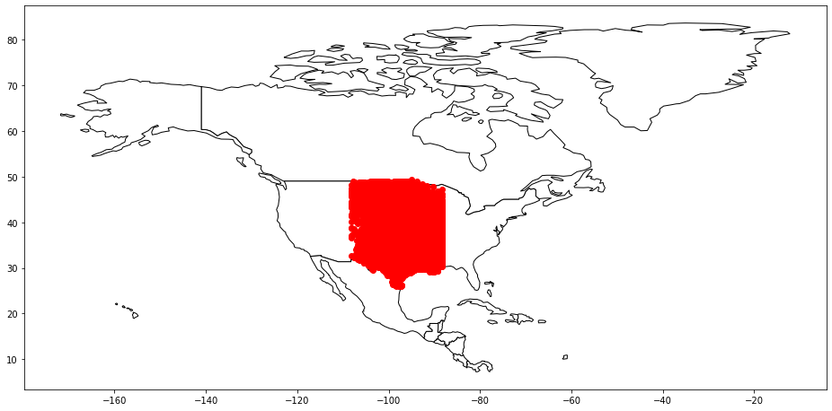
Methodology
Data pre-processing
Extract tornadoes within timeframe
Pandas [9]
Extract tornadoes within bounding box
GeoPandas [10]
Python script for downloading data
GrADS for processing gridded data [11]
Convert tornadoes to binary
Neural Network
Seed the network
Scikit-learn [12]
TensorFlow [13]
Notes:
Pandas Python library was used to restrict the tornado data to the years of the study. A mask was created and applied to the dataframe.
GeoPandas Python library can create a geodataframe from the Pandas dataframe. This was done to find all tornadoes that fall within the bounding box.
The Shapely library was used to create a polygon (the box) and the dataframe was queried and all tornadoes within that polygon were extracted
A Pandas series object was created to hold the count of tornadoes for each day. A reindex function was called to fill all missing dates in with 0s
A Python script was used to download the files from NCEP. From here, the grid files were passed to a GrADS script to extract the average of all meteorological variables used for the study.
The tornado data was converted to binary representation, 0 meaning less than 5 tornadoes and 1 for 5 or more tornadoes
In order to get consistent results in the neural networks, it is necessary to seed the network. This seeding was set via an environmental variable, and inside the TensorFlow package.
Scikit-learn library was used for the train/test/validation split and for converting the data to standardization

Slide 9
Neural Network Design
Ran 5 models for 12Z and 00Z
Network Design
Input Layer
26 neurons
ReLU activation
Uniform weight vector
Regularization term
Combination of L1 and L2
Fully Connected Hidden Layer
26 neurons
ReLU activation
Regularization term
Combination of L1 and L2
Dropout Layer
Output Layer
1 neuron
Sigmoid activation
Regularization term
Combination of L1 and L2
10 epochs
Batch size of 6,500
Notes:
The five models used different optimizers (SGD, Adam, Nadam, etc)
The NARR contains both 12Z and 00Z data
Regularization tries to control the complexity of the model. [14]
Dropout layer tries to prevent overfitting. Dropout will randomly choose neuron(s) to remove from the next calculation. [15]
This network design was the best performer out of different attempts. This very well could not be the best network design for this problem.

Slide 10
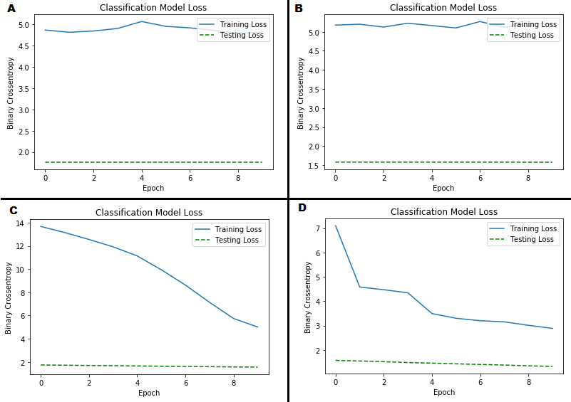
12Z Results – Model 1
Adadelta optimizer used
Learning rate = 0.001
Decay rate = 0.95
Constant = 1 x 10⁻⁷
Training and Validation Loss
Underfit signs [16]
High training
High validation
Overfit signs [16]
Low training
High validation
Notes:
The loss in this network is extremely high for training and validation, though training is much higher than the validation loss.
Signs that are indicators when looking at the loss graph is as following:
Underfit – high training and validation error (not learned enough)
Overfit – low training and high testing (model learns too much from data)
This network is not overfit. It could be argued that it is underfit as both training and validation are high, but it could be argued that it might not be able to be classified totally as underfit as training is higher than validation. If both were closer together, I would feel more confident on calling it underfit.
On research, Dr Jason Brownlee’s website on machine learning was found. He suggests that cross entropy values greater than 1 are pretty bad, which it is in this case. [17]

Slide 11
12Z Results – Model 2
Adagrad optimizer used
Learning rate = 0.001
Initial accumulator = 0.1
Constant = 1 x 10⁻⁷
Training and Validation Loss
Adadelta is modified version of Adagrad [18]
Notes:
This network essentially is the exact same results as the Adadelta model. But that makes complete sense since Adadelta is a modified version of Adagrad.
Once again the training loss is extremely high and validation loss is relatively high. I’m still not confident on calling this underfit

Slide 12
12Z Results – Model 3
Adam optimizer
Learning rate = 0.001
First exponential decay rate = 0.9
Second exponential decay rate = 0.999
Constant = 1 x 10⁻⁷
Training and validation loss
Confusion Matrix
Accuracy
71.8%
Error rate
28.2%
Recall
18% “yes”
90% “no”
Precision
38% “yes”
76% “no”
 | Predicted No | Predicted Yes
Actual No | 1721 | 191
Actual Yes | 529 | 116
Notes:
This network is the best performing thus far, even though I am more confident on calling this underfit due to training and validation loss getting closer at the end. It is possible if I added more epochs, the two losses might converge, which would indicate a good model. While not overly obvious, the validation loss does decrease through the epochs. It is possible with the training loss being so high that we can’t see the decrease in the validation loss.
This network has an accuracy of 71.8% on the testing data (the data the network has never seen).
Error rate is just subtracting 1 from the accuracy, and that gives us an error rate of 28.2%.
Recall shows us how many “yes” days were predicted correctly out of actual “yes”, or the same thing for “no” days. The “yes” recall was 18% and the “no recall” was 90%.
Precision shows how many “yes” days were predicted correctly out of the total predicted “yes”. The same idea for “no” days. Precision for “yes” was 38% and the precision for “no” was 76%.
While the accuracy seems really great, the recall and precision starts to show where the network is going wrong. The key point out of both recall and precision is that the network can predict days with less than 5 tornadoes better than it can days with five or more tornadoes. This most likely is the result of having more “no” days than “yes” days in the data set. This could also be the reason for classifying it as underfitting.

Slide 13
12Z Results – Model 4
NAdam optimizer
Learning rate = 0.001
Beta 1 = 0.9
Beta 2 = 0.999
Constant = 1 x 10⁻⁷
Training and validation loss
Notes:
This network is essentially the same as the last one, because of that and the less smooth curve, won’t discuss this further.
I am still fairly confident on calling this one underfit as both the training and validation loss values are greater than 1, but they are showing improvement, which is promising.

Slide 14
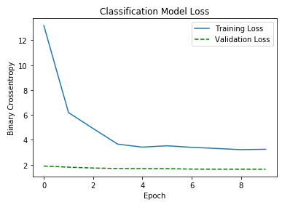
12Z Results – Model 5
Stochastic Gradient Descent optimizer
Learning rate = 0.01
Momentum = 0.0
Tuned
Learning rate = 0.001
Momentum = 0.5
Training and validation loss
Confusion Matrix
Accuracy
68.9%
Recall
20% “yes”
92% “no”
Precision
54% “yes”
71% “no”
 | Predicted No | Predicted Yes
Actual No | 1596 | 141
Actual Yes | 654 | 166
Notes:
Out of all networks, this one I feel is the best just by the curve. The training loss curve looks like curves I’ve seen in other classes and with other examples. However, I still can be fairly confident on calling this an underfit network.
Accuracy was less than Adam at 68.9%
Recall for “no” days was 92% and for “yes” was 20%
Precision for “no” days was 71% and “yes” is 54%
While overall accuracy decreased, the recall and precision increased for “yes” days. Recall and precision decreased slightly for “no” days, but as we want to predict days with tornadoes, I am happier with the increase in “yes” days
Given the loss graph and the confusion matrix, there is potential in using machine learning for this purpose

Slide 15
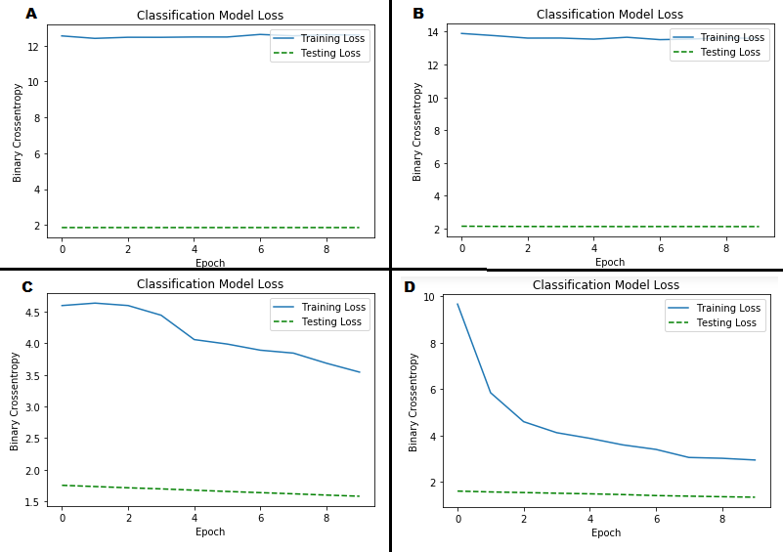
00Z First Four Models
Adadelta Loss
Adagrad Loss
Adam Loss
Nadam Loss
Notes:
All five networks were used exactly the same parameters as 12Z networks. Generally, the loss graphs are very close to being the same as the 12Z networks.
However, Nadam seems to be doing better for 00Z than it did for 12Z. In fact, it looks very similar to the 12Z SGD network.

Slide 16
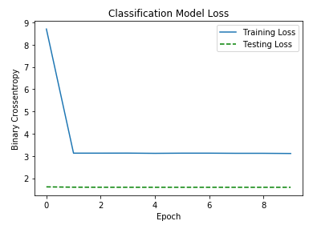
00Z SGD Model
All parameters same as 12Z
Training and validation loss
Confusion Matrix
Accuracy
76.77
Precision
19% “yes”
85% “no”
Recall
15% “yes”
88% “no”
Comparison to 12Z SGD Model
 | Predicted No | Predicted Yes
Actual No | 1903 | 255
Actual Yes | 339 | 60
Notes:
Since SGD worked best with 12Z data, it was thought that maybe it would be good for 00Z as well.
The loss graph essentially immediately says that this is not a good network for 00Z data as the training loss decreases and then stays constant for the rest of the epochs. It only needed two epochs and even then, I would consider this to be underfit.
Accuracy is 76.77%
Precision for “no” days is 85% while “yes” days is 19%.
Recall for “no” days is 88% and 15% for “yes” days.
Accuracy of the network, when compared to 12Z, increased. Precision went up for “no days” but drastically went down for “yes” days. Recall for both “no” and “yes” days went down.
So while the accuracy went up, I’m not happy with the precision drastically decreasing for “yes” days and recall decreasing for both. The training loss graph also does not look promising for this particular network.

Slide 17
00Z NAdam Model
All parameters same as 12Z
Training and validation loss
Confusion Matrix
Accuracy
87.29
Precision
13% “yes”
98% “no”
Recall
45% “yes”
89% “no”
Comparison to 00Z SGD Model
 | Predicted No | Predicted Yes
Actual No | 2191 | 274
Actual Yes | 51 | 41
Notes:
Nadam preformed best for 00Z data given the loss graph.
I would say this is underfit still, just like all the other networks.
Accuracy is 87.29%
Precision for “no” is 98% and 13% for “yes” days
Recall is 89% for “no” and 45% for “yes”
Compared to SGD for 00z, the accuracy using Nadam increased, precision increased for “no” and decreased for “yes”. Recall increased drastically for “no” and “yes”.
While precision decreased for “yes” days, all other parameters increased. This along with the loss graph, I think this is the best network for 00Z.

Slide 18
Conclusions
Issues with all 10 models
Possible reasons
Limiting factors
Enough data?
Wrong machine learning algorithm?
Not ruling out the effectiveness/accuracy of this problem
Notes:
Overall, I would have to say all the models were underfit. I believe this is due to having more days with less than 5 tornadoes than days with more than 5. I even changed it to be less than 3 or more than 3, and the results looked very similar.
https://towardsdatascience.com/what-are-overfitting-and-underfitting-in-machine-learning-a96b30864690
https://developers.google.com/machine-learning/crash-course/descending-into-ml/training-and-loss
Some reasons I think cause these issues:
The limited time, I didn’t have enough time to really tune the networks
As I already stated, not enough days with 5 or more tornadoes
Could I used the wrong algorithm? Would an ensemble be better? Or would Support Vector Machine, or decision tree be better? This would need to be investigated further
While there are issues, I think with more time, tornado prediction using ML, or even severe in general, could be better.

Slide 19
Future Work
Hyperparameter tuning
Additional data
Trying other machine learning algorithims
Gridpoints instead of average
Make more broad of problem to get more data
Severe wind and hail reports
Notes:
I would like to tune the hyperparameters more. I know Amazon Web Services has a tool that does this for you, so it might be something to look into
Getting 2014-2018 would add more data, and could potentially help the models learn better
Try using the networks but all the gridpoints instead of an average.
Using severe wind and hail might help the networks. Also, if this is wanted to be used for S2S, doing all severe together would be the best in my opinion
I’m not giving up on this. There is room for improvement and the improvement needs to be done in order to say yes this is good or no this won’t work.

Slide 20
References
1. Cohen, J., Coumou, D., Hwang, J., Mackey, L., Orenstein, P., Totz, S., Tziperman, E.: S2S reboot: An argument for greater inclusion of machine learning in subseasonal to seasonal forecasts. Wiley Interdisciplinary Reviews: Climate Change. 10, (2018).
2. Hwang, J., Orenstein, P., Cohen, J., Pfeiffer, K., Mackey, L.: Improving Subseasonal Forecasting in the Western U.S. with Machine Learning. Proceedings of the 25th ACM SIGKDD International Conference on Knowledge Discovery & Data Mining - KDD 19. 2325–2335 (2019).
3. Holmstrom, M., Liu, D., Vo, C.: Machine Learning Applied to Weather Forecasting. (2016).
4. Haberlie, A.M., Ashley, W.S.: A Method for Identifying Midlatitude Mesoscale Convective Systems in Radar Mosaics. Part I: Segmentation and Classification. Journal of Applied Meteorology and Climatology. 57, 1575–1598 (2018).
5. Mcgovern, A., Elmore, K.L., Gagne, D.J., Haupt, S.E., Karstens, C.D., Lagerquist, R., Smith, T., Williams, J.K.: Using Artificial Intelligence to Improve Real-Time Decision-Making for High-Impact Weather. Bulletin of the American Meteorological Society. 98, 2073–2090 (2017).
6. Ghosh, T., Krishnamurti, T.N.: Improvements in Hurricane Intensity Forecasts from a Multimodel Superensemble Utilizing a Generalized Neural Network Technique. Weather and Forecasting. 33, 873–885 (2018).
7. Vasquez, T.: Weather forecasting red book: forecasting techniques for meteorology. Weather Graphics Technologies, Garland, TX (2009).
8. Paul Sirvatka

Slide 21
References
9. https://pandas.pydata.org/
10. http://geopandas.org/
11. http://opengrads.org/
12. https://scikit-learn.org/stable/
13. https://www.tensorflow.org/
14. Bhaskara, A., Roy, C.D.: http://www.cs.utah.edu/~bhaskara/courses/theoryml/scribes/lecture19.pdf.
15. Srivastava, N., Hinton, G., Krizhevsky, A., Sutskever, I., Salakhutdinov, R.: Dropout: a simple way to prevent neural networks from overfitting. The Journal of Machine Learning Research. 15, 1929–1958 (2014).
16. Koehrsen, W.: Overfitting vs. Underfitting: A Complete Example, https://towardsdatascience.com/overfitting- vs-underfitting-a-complete-example-d05dd7e19765.
17 . https://machinelearningmastery.com/cross-entropy-for-machine-learning/
18. Zeiler, M.D.: ADADELTA: AN ADAPTIVE LEARNING RATE METHOD.

